Slide 1
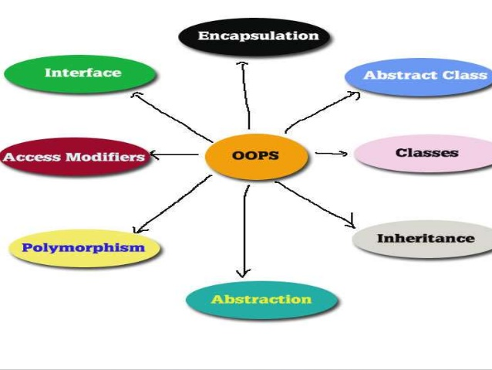
Object Oriented Programming & Design
Session – 1: 13-Oct-2019
Notes:
NOTE:
To change the image on this slide, select the picture and delete it. Then click the Pictures icon in the placeholder to insert your own image.

Slide 2

Agenda
Introduction
Objective of this Course
What will be covered
Recap of CP
Introduction to Algorithms
Introduction to Java
Introduction to Object Concepts
Self Study

Slide 3

Introduction
Who am I ??
Handout, the most critical reference for the course why?
  Units & Hours of Work
  Follow the guideline
  Summary of Course
  Schedule for Assignments & Exams
  Quick Reference guide
Text Book Prescribed
  The Java Programming Language, Ken Arnold, David Holmes, James Gosling, Prakash Goteti, 4th Edition, Pearson
Reference Book:
  Java: The Complete Reference by Herbert Schildt, 9th Ed, 2017
Where can I get this PPT?
  Link to Drive: OOPD Presentations on Drive

Slide 4

Objective of this course
To advance the programming skills students gathered in the course computer programming in their first semester and advance problem solving techniques by using the object oriented approach.
To teach object oriented programming concepts including polymorphism, encapsulation, overloading, inheritance.
Designing and implementing the solutions to problems using object oriented concepts

Slide 5

Our OOPD Sojourn
Module | Topic
M1 | INTRODUCTION TO OOP CONCEPTS
M2 | CLASSES , OBJECTS AND METHODS
M3 | PACKAGES, ARRAYS, STRINGS and STREAM
M4 | EXTENDING CLASSES - INHERITANCE
M5 | INTERFACES AND EXCEPTIONS
M6 | COLLECTIONS
M7 | MULTITHREADING
M8 | THE JAVA OBJECT MODEL
Important Dates
December 1st & 8th 2019: Mid Semester Exams
January 19th, 2020 : Assignment Submission date
Mar 1st & 8th 2020: Comprehensive Examinations
Quiz I & II
Will be notified appropriately

Slide 6
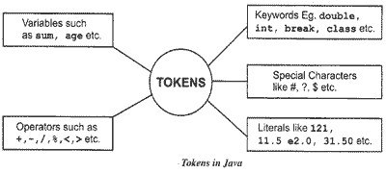
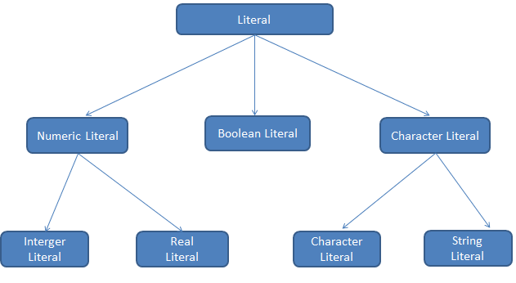
B2B : Back to Basics – A quick refresher
CP : A course intended to instill the virtues of Procedural Languages. What else did we cover?
Literals & Tokens
  A program starts as a sequence of characters contained in a file the source code. Interpreting those characters, according to the rules of a given language, is the job of the compiler, or interpreter.
  Some characters will represent the names of variables, others will be special keywords used by the language, still others will be operators or "punctuation" characters used to separate the other elements.
  All of these textual constructs form the lexical elements of the program.

Slide 7
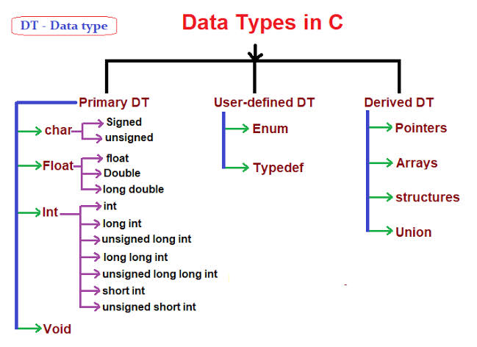
B2B : Back to Basics – A quick refresher
CP : A course intended to instill the virtues of Procedural Languages. What else did we cover?
Types
  Every expression has a type that determines what values the expression can produce. The type of an expression is determined by the types of values and variables used within that expression.
  Primitive types and the reference types
    Boolean either true or false
    char 16-bit Unicode UTF-16 code unit (unsigned)
    byte 8-bit signed two's-complement integer
    short 16-bit signed two's-complement integer
    int 32-bit signed two's-complement integer
    long 64-bit signed two's-complement integer
    float 32-bit IEEE 754 floating-point number

Slide 8
B2B : Back to Basics – A quick refresher
CP : A course intended to instill the virtues of Procedural Languages. What else did we cover?
Variables
A variable is a storage location something that can hold a value to which a value can be assigned.
Variables include fields, local variables in a block of code, and parameters.
A variable declaration states the identifier (name), type, and other attributes of a variable.
The type part of a declaration specifies which kinds of values and behavior are supported by the declared entity.
The other attributes of a variable include annotations and modifiers.
Annotations can be applied to any variable declaration

Slide 9
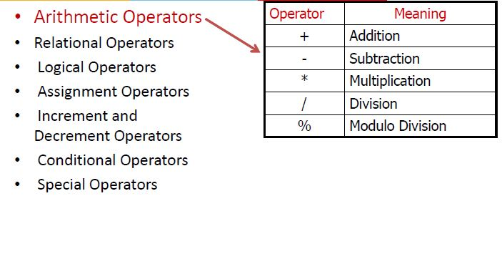
B2B : Back to Basics – A quick refresher
CP : A course intended to instill the virtues of Procedural Languages. What else did we cover?
Operators

Slide 10
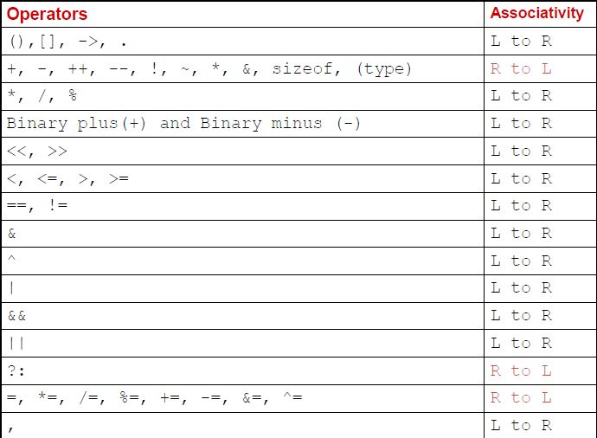
B2B : Back to Basics – A quick refresher
CP : A course intended to instill the virtues of Procedural Languages. What else did we cover?
Precedence & Associativity

Slide 11
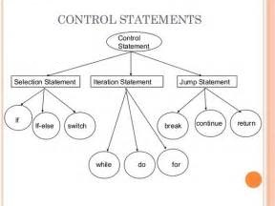
B2B : Back to Basics – A quick refresher
CP : A course intended to instill the virtues of Procedural Languages. What else did we cover?
Control Statements
Decision Making(or branching) Statements
  If statement
  If…else statement
  Else...if statement
  Nested if...else statement
  Switch statement
Loop or Repeating Construct
  For loop
  While loop
  Do…while loop
NOTE:
Branching is deciding what actions to take
looping is deciding how many times to take a certain action.

Slide 12
B2B : Back to Basics – A quick refresher
CP : A course intended to instill the virtues of Procedural Languages. What else did we cover?
What else?
Arrays
Structures
Unions
Pointers
Functions

Slide 13

The Integrated Development Environment - IDE
Do not underestimate the power of IDE

Slide 14
Eclipse IDE
Notes:
After installing JDK & downloading eclipse and starting eclipse, this is the first screen. Alternatively use Help ➔ Welcome

Slide 15
Eclipse IDE
Notes:
Check out the different views

Slide 16
Error Types
Errors of two types
  Compile Time Errors
  Detected by Eclipse as you type along or when you build the application
Run Time Errors
  Pointed out by Eclipse when you run the code.
  These are referred to as BUGS and the process of removing bugs is called debugging.

Slide 17
Debugging Features
Mechanisms for Pause
  A breakpoint tells to pause execution at a particular location within the program.
A watchpoint tells to pause execution when a particular memory location (or an expression involving one or more locations) changes value.
  A catchpoint tells to pause execution when a particular event occurs.

Slide 18
Breakpoint Overview
Overview of Breakpoints
A breakpoint is like a tripwire within a program: You set a breakpoint at a particular “place” within your program, and when execution reaches that point, the debugger will pause the program’s execution
The user can look up values of all variables at this time and decide to step through code step by step at this stage

Slide 19
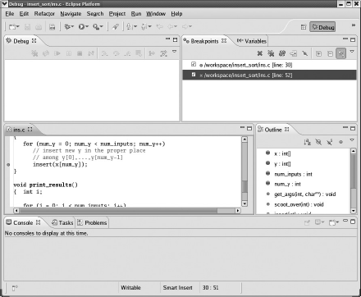
Breakpoint Overview
Breakpoint Lists in Eclipse
The Debug perspective includes a Breakpoints view. In Figure 2-2, for instance, you see that you currently have two breakpoints, at lines 30 and 52 of the file ins.c.
You can right-click the entry of any breakpoint to examine or change its properties. Also, double-clicking an entry will result in the focus of the source file window moving to that breakpoint.

Slide 20
Stepping
Step into:
  If a module is being called Step into will cause proceeding to the statements in the module.
  One statement is highlighted and processed at a time
Step Over
  The entire module is executed as if it had been stepped over and the execution stops on the statement after returning to the module.
  Step Return
  Control is returned from the module by running all steps remaining in the module.
Stepping
These features are to be set up in Debug Perspective
Click from Debug toolbar or press F7

Slide 21
Stepping
Persistence of Breakpoints
  Breakpoints are always identified by the line number.
  In case we add extra line of code, the breakpoint will be at the same line but not necessarily at the statement we want the debugger to halt.

Slide 22
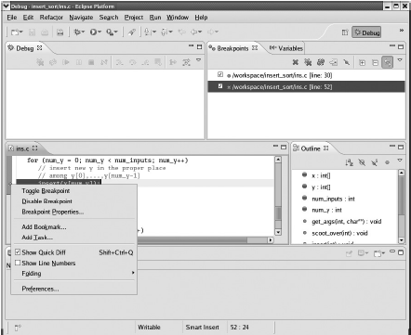
Breakpoint Overview
Deleting and Disabling Breakpoints in Eclipse
You can delete or disable a breakpoint in Eclipse by right clicking the breakpoint symbol in the line in question. A menu will pop up,
shown in Figure 2-5. Note that the Toggle option means to delete the breakpoint, while Disable/Enable means the obvious.

Slide 23
Step Filtering
You may specify which modules step filter should execute and return from.
Situations in which you wish to execute methods of only a given Class can be taken care of by this facility.
Run to Line
This is like setting a temporary breakpoint.
Go through Window > Preferences > Java > Debug > Step Filtering

Slide 24
Watch Points
Watches Points (or just Watches) allow you to view and change the value of a variable during execution
• In Eclipse, watches are set automatically on variables in scope
• Watches can be found in the Eclipse Debug perspective in the “Variables” window
• Eclipse allows you to change the value of variables dynamically during runtime

Slide 25
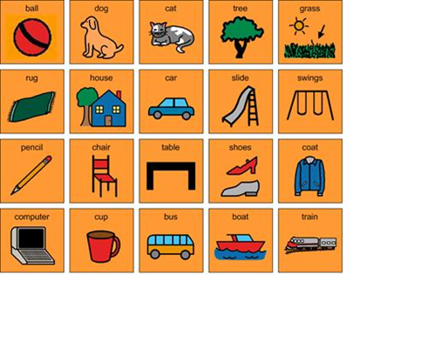
I - OBJECT
This is not a class on plenary session. Excuse the pun

Slide 26
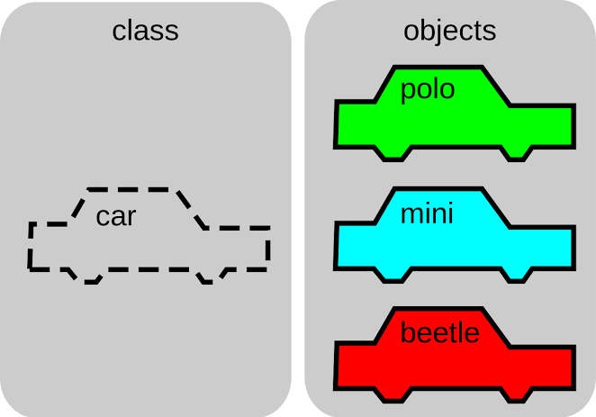
Let’s get Started : The Object in OOP Explained
An object is an encapsulation of data.
An object has
  identity (a unique reference),
  state, also called characteristics
  behavior
An object is an instance of an abstract type of an object.
An abstract type is implemented via a class.
Notes:
Source Wikipedia

Slide 27
Let’s get Started : The Object in OOP Explained
Class
  A class can be defined as a template/blueprint that describes the behavior/state that the object of its type support.
Object
  Objects have states and behaviors. Example: A dog has states - color, name, breed as well as behaviors – wagging the tail, barking, eating. An object is an instance of a class.
Notes:
Source Wikipedia

Slide 28
Let’s get Started : The Object in OOP Explained
Class vs Object
Class
A description of the common properties of a set of objects.
A concept.
A class is a part of a program.
Example 1: Person
Example 2: Vehicle
Object
A representation of the properties of a single instance.
A phenomenon.
An object is part of data and a program execution.
Example 1: Bill Clinton, Trump,.
Example 2: Car, Bus
Notes:
Source Wikipedia

Slide 29
Let’s get Started : The Object in OOP Explained
Objects are key to understanding object-oriented technology. Look around right now and you'll find many examples of real-world objects: your dog, your desk, your television set, your bicycle.
Real-world objects share two characteristics: They all have state and behavior.
Dogs have state (name, color, breed, hungry) and behavior (barking, fetching, wagging tail).
Identifying the state and behavior for real-world objects is a great way to begin thinking in terms of object-oriented programming.
For each object that you see, ask yourself two questions: "What possible states can this object be in?" and "What possible behavior can this object perform?".
As you do, you'll notice that real-world objects vary in complexity; your desktop lamp may have only two possible states (on and off) and two possible behaviors (turn on, turn off), but your desktop radio might have additional states (on, off, current volume, current station) and behavior (turn on, turn off, increase volume, decrease volume, seek, scan, and tune). These real-world observations all translate into the world of object-oriented programming.
Notes:
Source Wikipedia

Slide 30
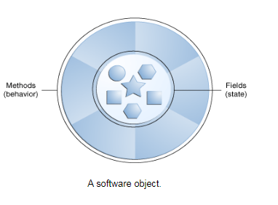
Let’s get Started : The Object in OOP Explained
Software objects are conceptually similar to real-world objects: they too consist of state and related behavior.
An object stores its state in fields (variables in some programming languages) and exposes its behavior through methods (functions in some programming languages).
Methods operate on an object's internal state and serve as the primary mechanism for object-to-object communication.
Hiding internal state and requiring all interaction to be performed through an object's methods is known as data encapsulation — a fundamental principle of object-oriented programming.
Notes:
Source Wikipedia

Slide 31
B2P : Back to the Present
OOPD : A course intended to instill the virtues of Object Oriented Programming
What is OOP ?
Object-oriented programming (OOP) refers to a type of computer programming (software design) in which programmers define not only the data type of a data structure, but also the types of operations (functions) that can be applied to the data structure.
In this way, the data structure becomes an object that includes both data and functions. In addition, programmers can create relationships between one object and another. For example, objects can inherit characteristics from other objects.
The focus of procedural programming is to break down a programming task into a collection of variables, data structures, and subroutines, whereas in object-oriented programming it is to break down a programming task into objects that expose behavior (methods) and data (members or attributes) using interfaces.
The most important distinction is that while procedural programming uses procedures to operate on data structures, object-oriented programming bundles the two together, so an "object", which is an instance of a class, operates on its "own" data structure.
Notes:
Source Wikipedia

Slide 32
Let’s get Started
What is Java?
Java is a programming language created by James Gosling from Sun Microsystems (Sun) in 1991. The target of Java is to write a program once and then run this program on multiple operating systems.
The Java language was designed with the following properties:
  Platform independent: Java programs use the Java virtual machine as abstraction and do not access the operating system directly. This makes Java programs highly portable. A Java program (which is standard-compliant and follows certain rules) can run unmodified on all supported platforms, e.g., Windows or Linux.
  Object-orientated programming language: Except the primitive data types, all elements in Java are objects.
  Strongly-typed programming language: Java is strongly-typed, e.g., the types of the used variables must be pre-defined and conversion to other objects is relatively strict, e.g., must be done in most cases by the programmer.
Notes:
Source Wikipedia

Slide 33
Let’s get Started
What is Java?
Java is a programming language created by James Gosling from Sun Microsystems (Sun) in 1991. The target of Java is to write a program once and then run this program on multiple operating systems.
The Java language was designed with the following properties:
  Interpreted and compiled language: Java source code is transferred into the bytecode format which does not depend on the target platform. These bytecode instructions will be interpreted by the Java Virtual machine (JVM). The JVM contains a so called Hotspot-Compiler which translates performance critical bytecode instructions into native code instructions.
  Automatic memory management: Java manages the memory allocation and de-allocation for creating new objects. The program does not have direct access to the memory. The so-called garbage collector automatically deletes objects to which no active pointer exists.
Notes:
Source Wikipedia

Slide 34
Let’s get Started : Object Advantage
Bundling code into individual software objects provides a number of benefits, including:
Modularity: The source code for an object can be written and maintained independently of the source code for other objects. Once created, an object can be easily passed around inside the system.
Information-hiding: By interacting only with an object's methods, the details of its internal implementation remain hidden from the outside world.
Code re-use: If an object already exists (perhaps written by another software developer), you can use that object in your program. This allows specialists to implement/test/debug complex, task-specific objects, which you can then trust to run in your own code.
Pluggability and debugging ease: If a particular object turns out to be problematic, you can simply remove it from your application and plug in a different object as its replacement. This is analogous to fixing mechanical problems in the real world. If a bolt breaks, you replace it, not the entire machine.
Notes:
Source Wikipedia

Slide 35
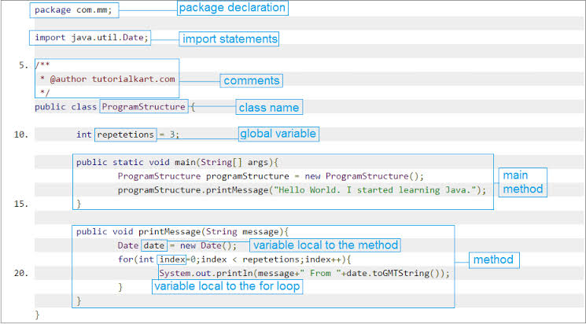
Let’s get Started : Your first taste of Java
Notes:
Source Wikipedia

Slide 36
Let’s get Started : A class on Class
In the real world, you'll often find many individual objects all of the same kind.
Java is strictly an objected-oriented programming language. All the Java code that you write will appear in either a class or an interface.
When you write a program using an object-oriented programming language, you design your program around the objects in the problem being solved.
For each object, a class is written to describe the object’s attributes and behaviors.
By definition, a class is a description of an object. Similarly, an object is defined to be an instance of a class.
An object consists of attributes and behaviors.
An attribute is a feature of the object, something the object “has.” A behavior is something the object “does.”
Each attribute of an object is denoted as a field in the class.
Each behavior of an object becomes a method in the class.
Notes:
Source Wikipedia

Slide 37
Let’s get Started : Still, why do we need Class
Java is an OOP Language, hence all programs written in java will have to be in a class or interface. Benefits of going the OOP way
  Modularity for easier trouble shooting: In procedural or functional, you may have to navigate through several lines of code to identify the issue (Assuming the code is well documented).
  In OOP, you get to know which object is at fault and can directly look for issues within that object
  Code Reuse through Inheritance: OOP introduces a new concept where you can start with one object and then keep adding enhancements to its methods and attributes by a process called inheritance.
  This ensures that you don’t have to recreate the object every time you have to add a new method or attribute
  Flexibility through Polymorphism: One object multiple behavior depending on external stimuli made possible by polymorphism.
  Effective problem solving: You can break down complex programs into abstract concepts, you can even plan the implementation of such concepts at a later stage enabling you to visualize the complex program devoid of its true complexity
Notes:
OK (just) for things with two data members Unmanageable for more complex things e.g., rectangle with width, height, text, font, line style, text colour, background colour, ... Also error prone e.g., bank account with name, balance, PIN Need to be able to combine lower-level data items into a higher-level unit of data

Slide 38
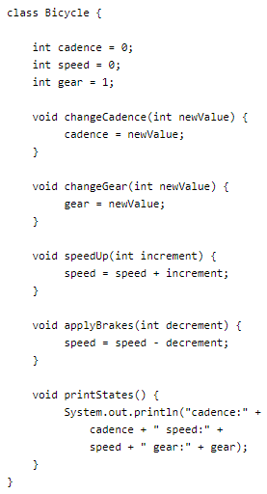
Let’s get Started : First Class
We will define the blueprint for creating an object called Bicycle.
We will define the Bicycle class to have the following attribute ➔ variables
  Name, Speed, Gear
We will define the Bicycle class to have the following behavior ➔ Methods
  change Name, changeGear, speedup, applyBrakes
  printStates
In object-oriented terms, we say that your bicycle is an instance of the class of objects known as bicycle.
The fields cadence, speed, and gear represent the object's state, and the methods (changeName, changeGear, speedUp etc.) define its interaction with the outside world.
Notes:
Source Wikipedia

Slide 39
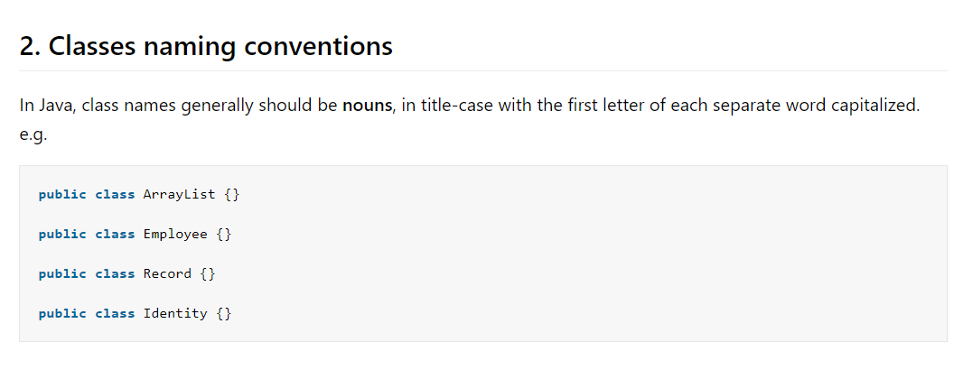
Let’s get Started : Class Constituents
A class can have three kinds of members:
  Fields are the data variables associated with a class and its objects and hold the state of the class or object.
  Methods contain the executable code of a class and define the behavior of objects.
  Nested classes and nested interfaces are declarations of classes or interfaces that occur nested within the declaration of another class or interface.
Notes:
OK (just) for things with two data members Unmanageable for more complex things e.g., rectangle with width, height, text, font, line style, text colour, background colour, ... Also error prone e.g., bank account with name, balance, PIN Need to be able to combine lower-level data items into a higher-level unit of data

Slide 40
Let’s get Started : Class Modifiers
A class may be declared with one or more modifiers which affect its runtime behavior:
  Access modifiers: public, protected, and private
  Modifier requiring override: abstract
  Modifier restricting to one instance: static
  Modifier prohibiting value modification: final
  Modifier forcing strict floating point behavior: strictfp
Not all modifiers are allowed on all classes, for example an interface cannot be final and an enum cannot be abstract.
A class declaration can be preceded by several modifiers.
Modifiers are allowed in any order, but the consensus is that you adopt a consistent order to improve the readability of your code. We always use, and recommend, the order listed.
Notes:
OK (just) for things with two data members Unmanageable for more complex things e.g., rectangle with width, height, text, font, line style, text colour, background colour, ... Also error prone e.g., bank account with name, balance, PIN Need to be able to combine lower-level data items into a higher-level unit of data

Slide 41
Let’s get Started : Class Members (Variables)
class's variables are called fields; the Bicycle class's cadence , speed and gear variables are examples.
A field declaration consists of a type name followed by the field name and optionally an initialization clause to give the field an initial value.
Giving each separate object a different instance of the fields means that each object has its own unique state such fields are known as instance variables.
Changing the cadence field in one Bicycle object does not affect the cadence field in any other Bicycle object.

Slide 42
Let’s get Started : Class Modifiers
Field declarations can also be preceded by modifiers that control certain properties of the field:
  access modifiers
  static
  final
  transient This relates to object serialization.
  volatile This relates to synchronization and memory model issues
A field cannot be both final and volatile.
When multiple modifiers are applied to the same field declaration, we recommend using the order listed above.
When a field is declared it can be initialized by assigning it a value of the corresponding type. In the Bicycle example, the cadence, speed field are initialized to the value zero.
Notes:
Serialization in java is a mechanism of writing the state of an object into a byte stream. It is mainly used in Hibernate, RMI, JPA, EJB and JMS technologies. The reverse operation of serialization is called deserialization.

Slide 43
Let’s get Started : Class Members (Variables)
Static Fields
Sometimes you want only one instance of a field shared by all objects of a class.
You create such fields by declaring them static, so they are called static fields or class variables.
When you declare a static field in a class only one copy of the field exists, no matter how many instances of the class are created.
2.2.3. final Fields
A final variable is one whose value cannot be changed after it has been initialized any attempt to assign to such a field will produce a compile-time error. We have seen final fields used to define named constants because constants don't change value
Notes:
Serialization in java is a mechanism of writing the state of an object into a byte stream. It is mainly used in Hibernate, RMI, JPA, EJB and JMS technologies. The reverse operation of serialization is called deserialization.

Slide 44
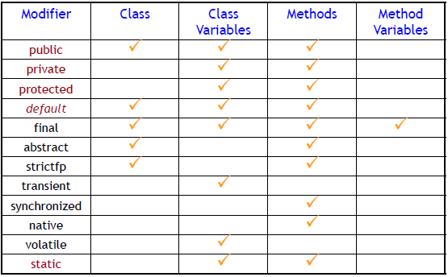
Let’s get Started : A class on Class
Notes:
Source Wikipedia

Slide 45
Let’s get Started : Back to the class
  You may have noticed that the Bicycle class does not contain a main method.
  That's because it's not a complete application; it's just the blueprint for bicycles that might be used in an application.
  The responsibility of creating and using new Bicycle objects belongs to some other class in your application.
  Here's a BicycleDemo class that creates two separate Bicycle objects and invokes their methods:

Slide 46
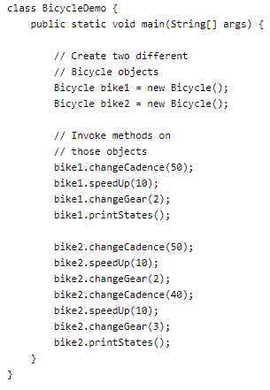
Let’s get Started : The Genesis, Let there be Objects

Slide 47

Questions ?
You can contact me @
avadekkedhil@wilp.bits-pilani.ac.in
9881300394

